Slide 1
8086
Microprocessor
Presented by:
Dr. Sk Babar Ali
Associate Professor
ECE department, Aliah University

Slide 2
Features of 8086 Microprocessor:
It is a 16-bit microprocessor.
The 8086 microprocessor has a 20-bit address bus that can access up to 2²⁰ memory locations (1 MB). Address ranges from 00000H to FFFFFH
It can support up to 64K I/O ports.
It provides fourteen 16-bit registers.
It has multiplexed address and data bus AD0- AD15 and A16 – A19.
It requires single phase clock with 33% duty cycle to provide internal timing.
The 8086 microprocessor is designed to operate in two modes, Minimum and Maximum.
It can pre fetches up to 6 instruction bytes from memory and queues them in order to speed up instruction execution.
A 40 pin dual in line package. It requires +5V power supply.
Memory is byte addressable - Every byte has a separate address.
The 8086 microprocessor employs parallel processing.

Slide 3
Internal Architecture of 8086
• 8086 has two blocks BIU and EU.
• The BIU performs all bus operations such as instruction fetching, reading and writing operands for memory and calculating the addresses of the memory operands.
• The instruction bytes are transferred to the instruction queue.
• EU executes instructions from the instruction system byte queue.
Both units operate asynchronously to give the 8086 an overlapping instruction fetch and execution mechanism which is called as Pipelining. This results in efficient use of the system bus and system performance.
• BIU contains Instruction queue, Segment registers, Instruction pointer, Address adder.
• EU contains Control circuitry, Instruction decoder, ALU, Pointer and Index register, Flag register.

Slide 4
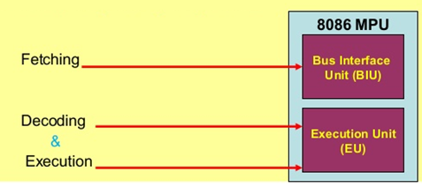
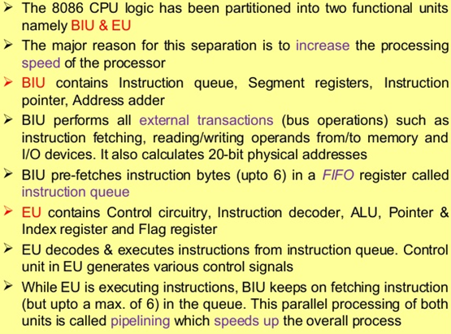
Both unit operates at the same time means, instruction fetching, execution simultaneously to speed the process.

Slide 5
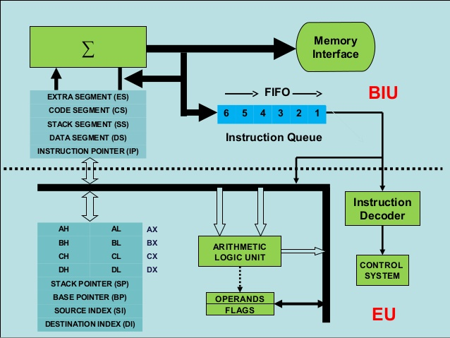

Slide 6
Bus Interface Unit:
Sends out addresses for memory locations
Fetches Instructions from memory
Reads/Writes data to memory
Sends out addresses for I/O ports
Reads/Writes data to Input/output ports
Execution Unit:
Tells BIU (addresses) where to fetch instructions or data.
Decodes & Executes instructions fetched by BIU unit.
Dividing the work between BIU & EU speeds up processing.
Generates control signals.

Slide 7
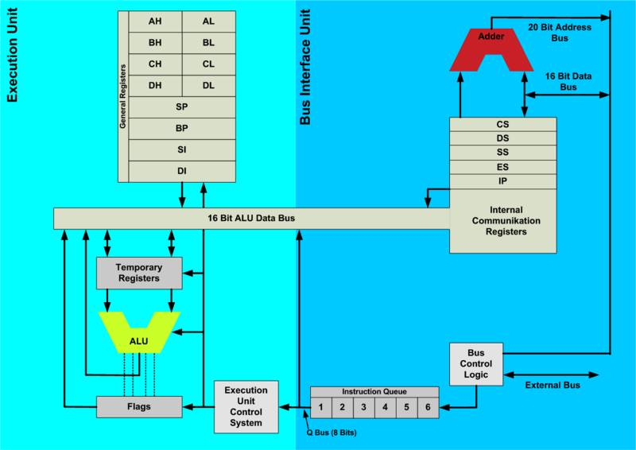

Slide 8
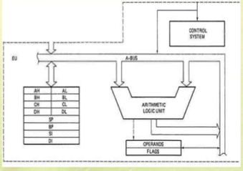
Main components of Execution Unit bare:
Instruction Decoder Control System
Arithmetic Logic Unit General Purpose Registers
Flag Register Pointer & Index registers
Instruction Decoder:
Translates instructions fetched from memory into a series of actions which EU carries out.
Control System:
It generates timing and control signals to perform the internal operations of the microprocessor.
Arithmetic Logic Unit:
EU has a 16-bit ALU which can ADD, SUBTRACT, AND, OR, increment, decrement, complement or shift binary numbers.

Slide 9
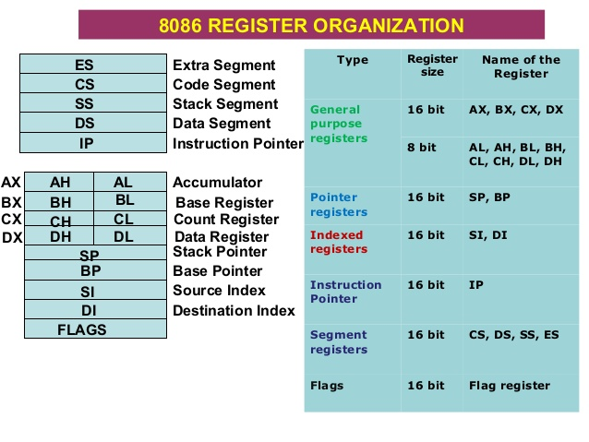
General Purpose Registers:
The EU has four 16-bit general purpose registers (AX, BX, CX, and DX).
These registers can be used in dual operation operations.
Each of these 16-bit registers is further subdivided into two 8-bit registers (upper and lower byte).
To store 8 bit data individually (AL, AH, BL, BH, CL, CH, DL and DH) and store 16 bit data to AX, BX, CX and DX for programming execution purpose.
The valid register pairs are – AX, BX, CX, and DX.

Slide 10
AX:
AX a 16 bit accumulator, with lower 8-bita of AX designated as AL and higher 8-bits as AH.
AL can be used as an 8-bit accumulator for 8-bit operations.
Used for operations involving input/output and most arithmetic.
During execution of a 16-bit multiply and divide instructions, AX contains the one-word operand and the result is stored in the accumulator.
BX:
BX is known as the Base register.
This is only general purpose register whose contents can be used for addressing 8086 memory. It holds the offset address of a location in the memory.
All memory reference utilizing this register content for addressing uses the DS as the default segment register.
BX can also be combined with DI or SI as a base register for special addressing.
BX register is similar to the 8085 HL register.

Slide 11
CX:
CX is known as a default counter register in case of string and loop instructions.
It may contain a value to control the number of times a loop is repeated when LOOP instruction is used or a value to shift bits left or right when the shift/rotate instruction is used.
CL is used to hold the count value while executing the shift/rotate instructions.
DX:
DX is known as a data register
Used to hold 16 bit result (data).
It is used to hold the I/O device address while executing the IN and OUT instructions.
DX is used to hold a part of the result during a multiplication operation and a part of the dividend before a division operation

Slide 12
General Purpose Registers:
Register | Purpose
AX | Word multiply, word divide, word I /O
AL | Byte multiply, byte divide, byte I/O, decimal arithmetic
AH | Byte multiply, byte divide
BX | Store address information
CX | String operation, loops
CL | Variable shift and rotate
DX | Word multiply, word divide, indirect I/O (Used to hold I/O address during I/O instructions. If the result is more than 16-bits, the lower order 16-bits are stored in accumulator and higher order 16-bits are stored in DX register)

Slide 13
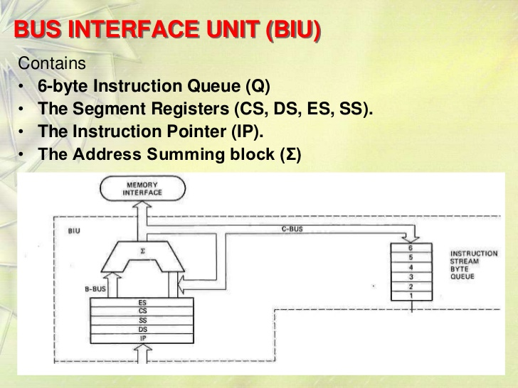

Slide 14
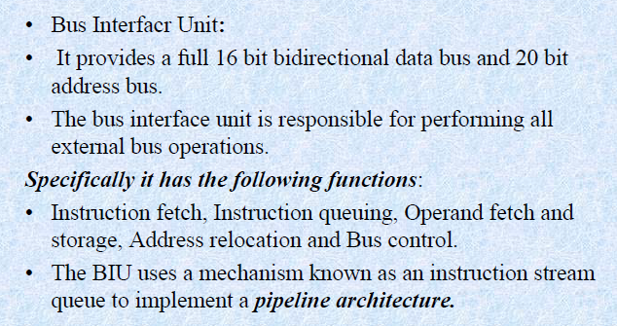
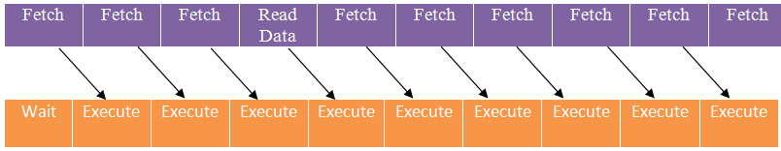
Bus Interface Unit:

Slide 15
Pipeline Architecture :
When the fetched instruction is executed internally, the external bus is used to fetch the machine code of the next instruction and arrange it in a queue known as pre decoded instruction byte queue.
It is a 6-byte long, first-in-first-out structure.
The instructions from the queue are taken by the Execution Unit (EU) for decoding sequentially.
Once a byte is decoded, the queue is rearranged by pushing it out and the queue status is checked for the possibility of the next opcode fetch cycle. While the opcode of new is fetched by the Bus Interface Unit (BIU), the Execution Unit (EU) executes the previously decoded instruction concurrently.
Depending upon the execution time of the instruction, the BIU can fill the queue with instructions. The Bus Interface Unit (BIU) along with the Execution Unit (EU) thus forms a pipeline.
Thus, the 8086 microprocessor employs parallel processing that makes the fetch and execution of instructions independent operation.
The advantage of this architecture is that the EU executes instructions continuously without waiting of fetching the instruction in BIU.

Slide 16
Memory Segmentation :
The 8086 microprocessor has a 20-bit address bus. So, it can address a maximum of 1MB of memory.
In memory segmentation, the complete 1 MB memory can be divided into 16 logical segments.
Each segment thus contains 64 KB of memory.
The 8086 can work with only four 64KB segments at a time within this 1MB .
These four memory segments are called:
Code segment Memory- used for storing the instructions.
Stack segment Memory - used as a stack and it is used to store the return addresses.
Data segment Memory - used for storing data byte.
Extra segment Memory - used for storing data byte.
Segment | Starting Address | End Address
1st Segment | 00000 H | 0FFFF H
2nd Segment | 10000 H | 1FFFF H
3rd Segment | 20000 H | 2FFFF H
4th Segment | 30000 H | 3FFFF H
---------- | ------------ | --------------
---------- | ------------ | -------------
16th Segment | F0000 H | FFFFF H

Slide 17
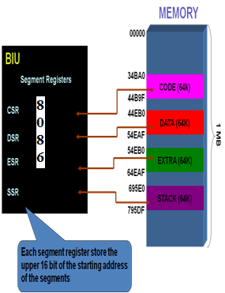
Code Segment (CS): It is used for addressing a memory location in the code segment of a memory in which program is stored for execution. The Code Segment register holds the upper 16 bits of the starting address of the segment in the memory bank.
Data segment (DS): It points to the data segment of memory, where data is stored. The Data Segment register holds the upper 16 bits of the starting address of the segment in the memory bank.
Extra segment (ES): It is a segment which can be used as another data segment of the memory pointed by Extra Segment register. Therefore ES contains data. The Extra Segment register holds the upper 16 bits of the starting address of the segment in the memory bank.
Stack segment (SS): It is used for addressing stack segment of memory in which stack data is stored. The CPU uses the stack for temporarily storing data i.e. the content of all general purpose registers which will be used later. The Stack Segment register holds the upper 16 bits of the starting address of the segment in the memory bank.

Slide 18
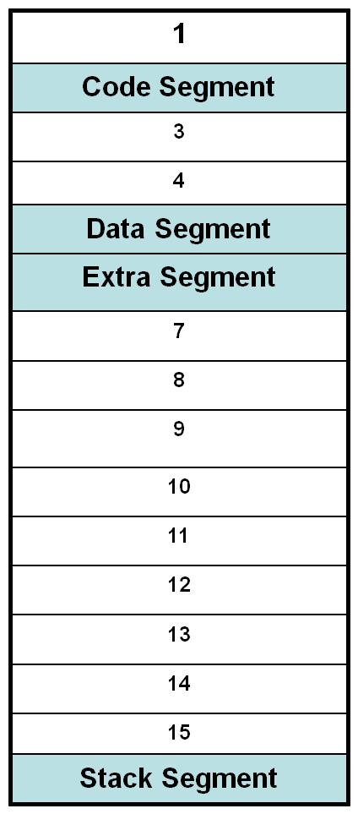
Memory
00000H
The 16 bit contents of the segment registers in the BIU actually point to the starting location of a particular segment.
A segment register is used to hold the upper 16-bits of the starting address for each of the segments.
The BIU always inserts zeros for the lowest 4 bits of the 20-bit starting address for a segment.
If a segment register contains 1234H, then segment will start at address 12340H.
CS
1000 0H
DS
4000 0H
ES
5000 0H
1MB Address Range
Starting Addresses of Segments
SS
F000 0H
FFFFFH

Slide 19
Advantages of memory segmentation:
It allows the memory addressing capacity to be 1 M byte even though the address associated with individual instruction is only 16-bit.
It allows instruction code, data stack and portion of program to be more than 64kb long by using more than one code, data, stack segment and extra segment.
Allows the placing of code, data and stack portions of the same program in different parts of memory for data and code protection.
Program can be relocated which is very useful in multiprogramming.
An immediate advantage of having separate data and code segments is that one program can work on several different sets of data.
The greatest advantage of segmented memory is that programs that reference logical addresses only can be loaded and run anywhere in memory. This is because the logical addresses always range from 00000h to 0FFFFh, independent of the code segment base.
Such programs are said to be re-loadable, meaning that they will run at any location in memory.

Slide 20
Instruction pointer:
The instruction pointer register contains a 16-bit offset address of instruction that is to be executed next.
The IP always combine with the Code segment register (CS) to generate 20-bit physical address.
The value contained in the instruction pointer is called as an offset because this value must be added to the base address of the code segment, which is available in the CS register to find the 20-bit physical address.
The value of the instruction pointer is incremented by two after executing every instruction because 8086 reads two bytes at a time.
To form a 20bit address of the next instruction, the 16 bit address of the IP is added (by the address summing block) to the address contained in the CS, which has been shifted four bits to the left.

Slide 21
Pointer & Index Registers:
The 8086 has (16-bit) two pointer registers Stack Pointer (SP)and Base Pointer (BP), and two index registers Destination Index(DI)and Source Index(SI).
These are used to store offset addresses.
An offset address represents the displacement of a storage location in memory from the segment base address in a segment register.
Unlike the general-purpose data registers, the pointer and index registers are only accessed as words (16 bits) from memory segment register.
Pointer Registers:
The two pointer registers (16 bits), stack pointer (SP) and base pointer (BP) are used to access data in the stack segment.
The 16 bit SP register holds the offset address of top stack memory location, which is used with the SS register (SP: SS), to access memory locations within the stack segment for PUSH, POP, CALL and RET instructions.
The 16 bit BP Primarily used to hold the offset address of the data to be read from or written into the stack segment and can be used to access data in other segments.
The processor combines the address in SS with the offset in BP.
BP can also be combined with DI and with SI as a base register for special addressing.

Slide 22
Index Registers:
The two 16 bit index registers, Source Index (SI) and Destination Index (DI) are used in indexed addressing.
SI register is required for some string (character) handling operations. It is used to hold the offset address of the source data in the data segment, while executing string instructions. Thus, SI is associated with the DS in string operations.
DI register is also required for some string operations. It is used to hold the offset address of the destination data in the extra segment, while executing string instructions. Thus, DI is associated with the ES in string operations.

Slide 23
Accessing Memory Locations:
To access an operand (either data or instruction) from a particular segment of the memory, the 8086 has to first calculate the physical address of that operand.
For this task, the 8086 adds the base address of the corresponding segment with an offset address.
Segment Register | Default Offset Register | Function
CS (Code Segment) | IP | Address of Next Instruction
DS (Data Segment) | BX,SI,DI,8-bit or 16-bit | Address of Data
SS (Stack Segment) | SP & BP | Address in the Stack
ES (Extra Segment) | DI for string operation | Address of destination data
Suppose CS register contains 348A H, the starting address of the code segment will be 348A0. When the BIU adds the offset address 4214 H in IP to this segment base address, the result will be 20-bit physical address of 38AB4 H.

Slide 24
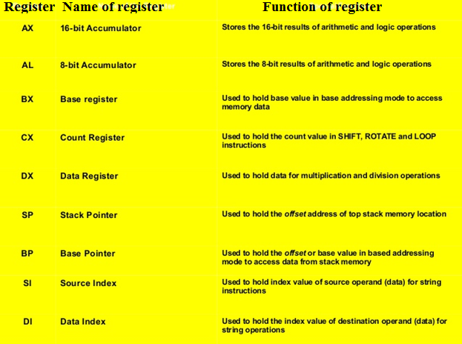

Slide 25
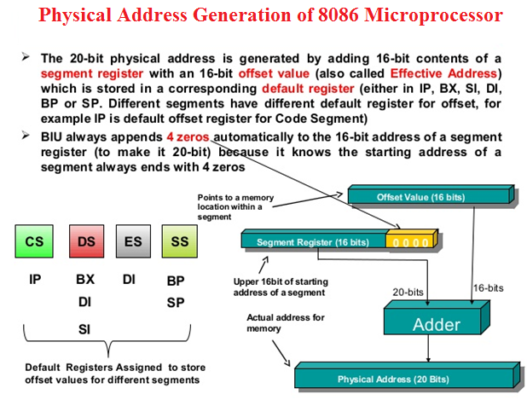

Slide 26
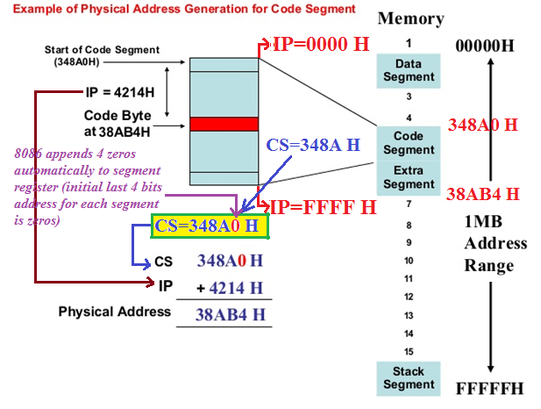

Slide 27
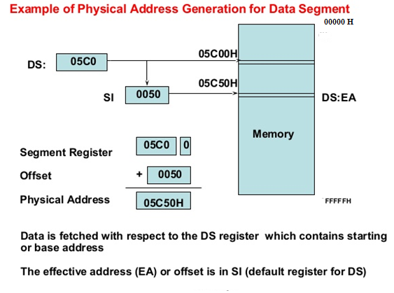

Slide 28
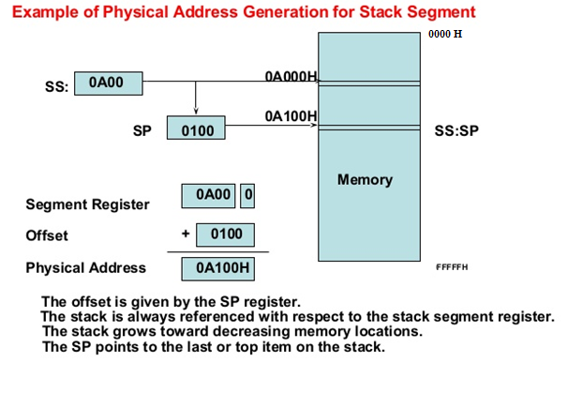

Slide 29
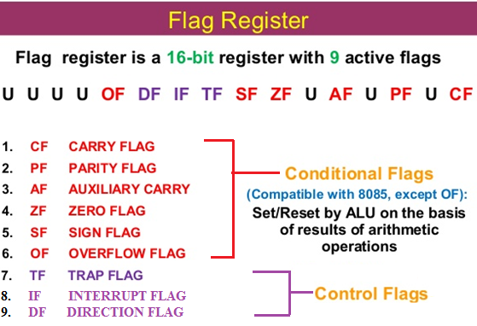

Slide 30
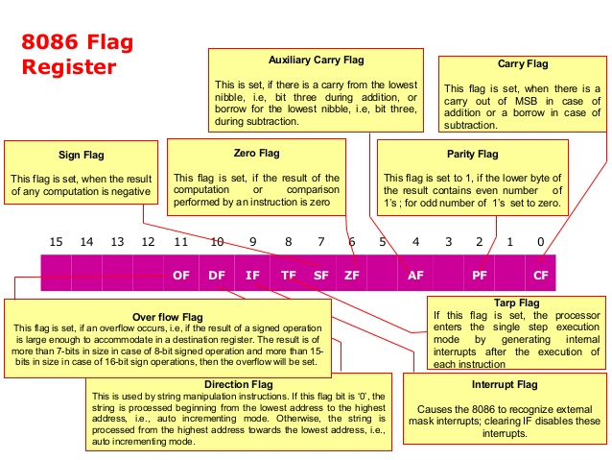

Slide 31
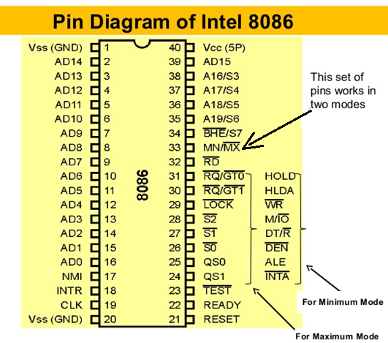

Slide 32
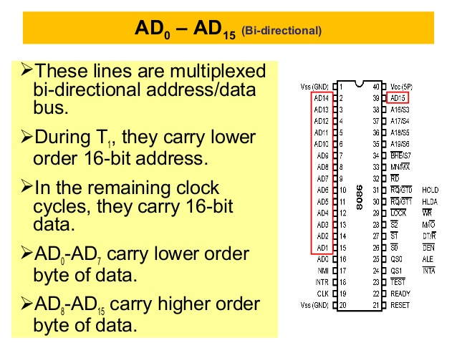

Slide 33
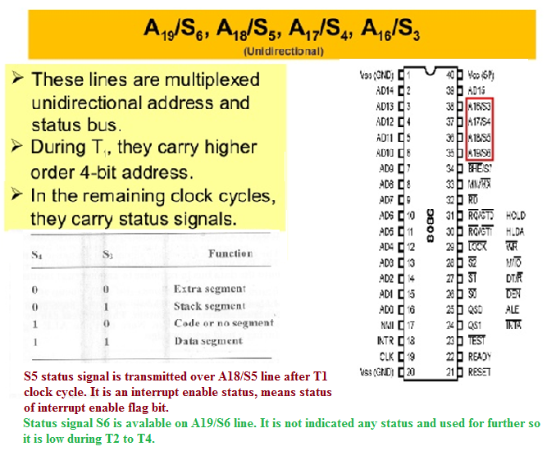

Slide 34
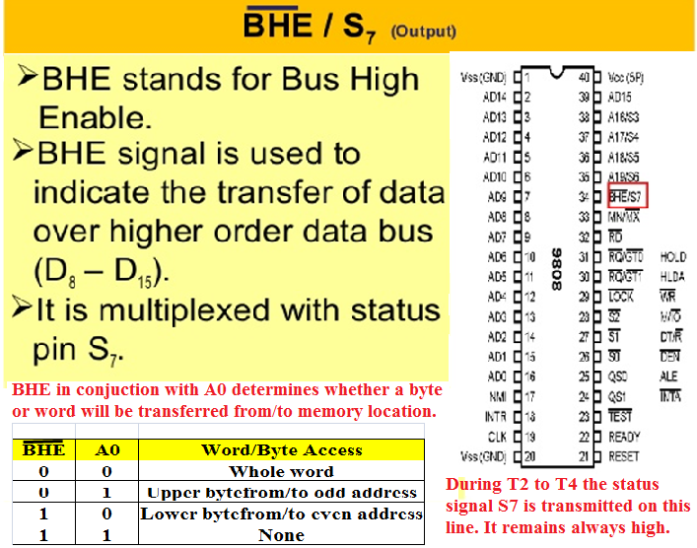

Slide 35
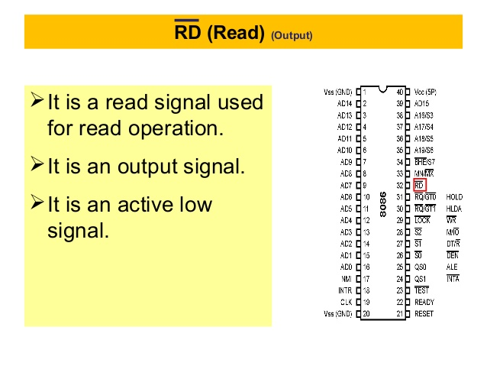

Slide 36
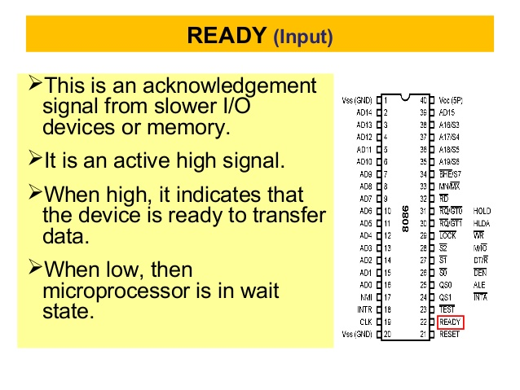

Slide 37
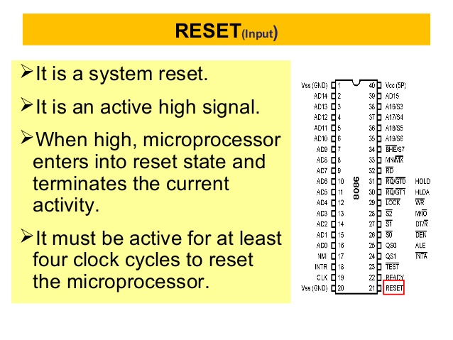

Slide 39
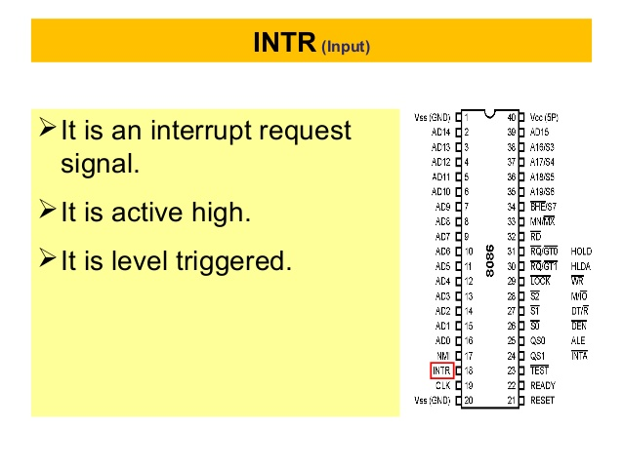

Slide 40
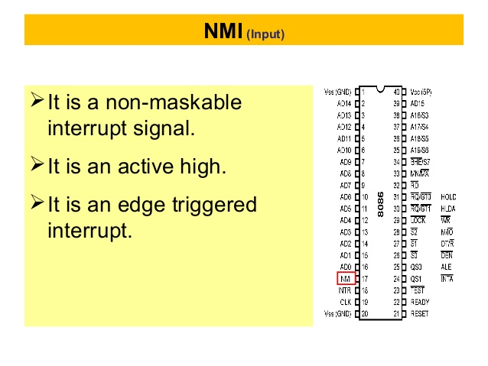

Slide 41
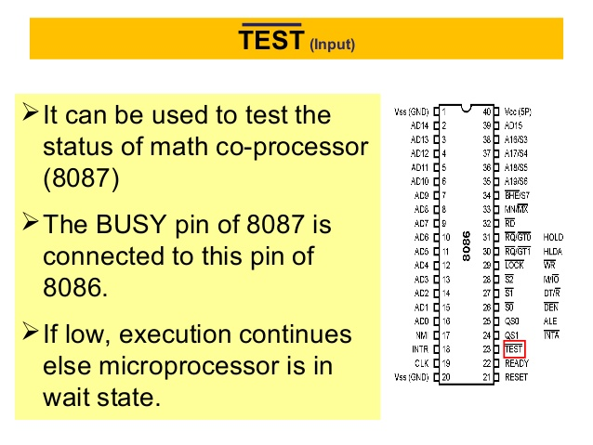

Slide 42
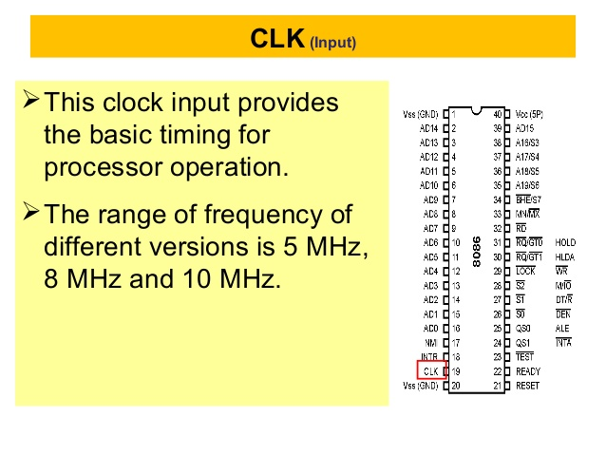

Slide 43
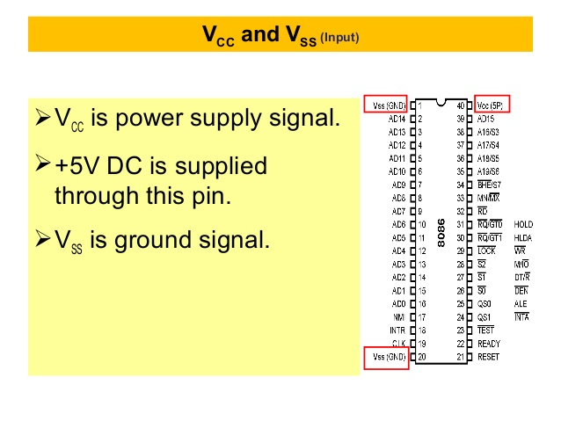

Slide 44
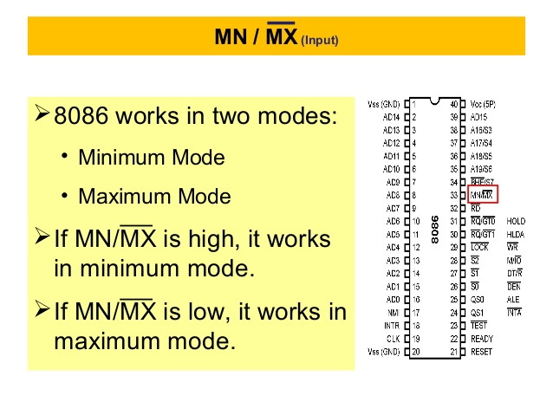

Slide 45
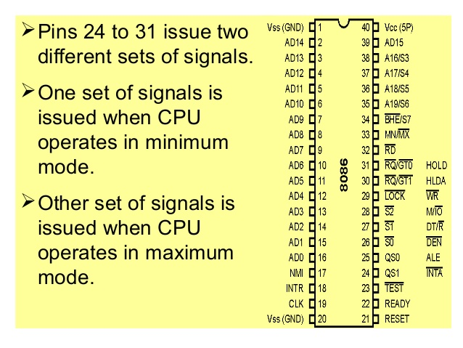

Slide 46
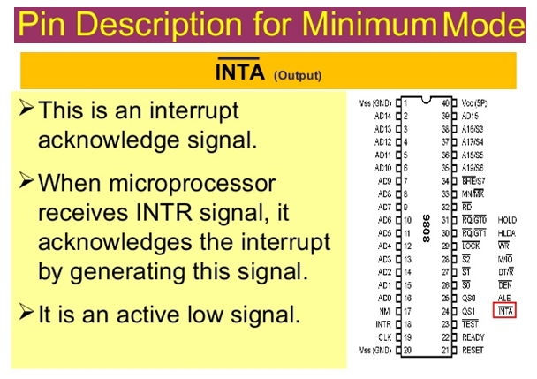

Slide 47
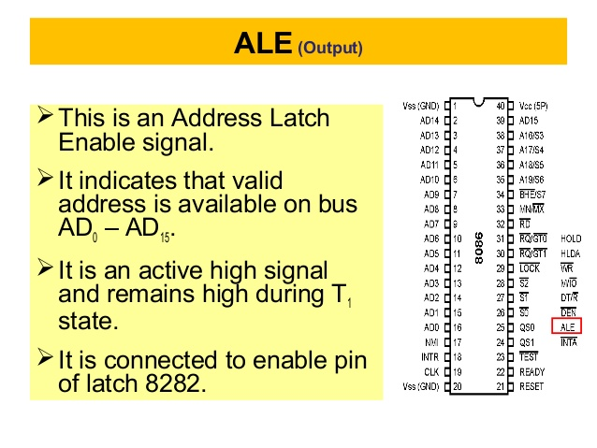

Slide 48
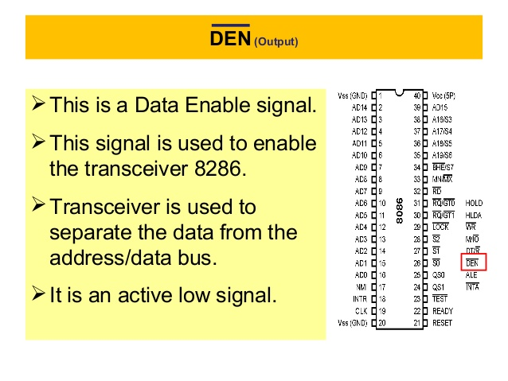

Slide 49
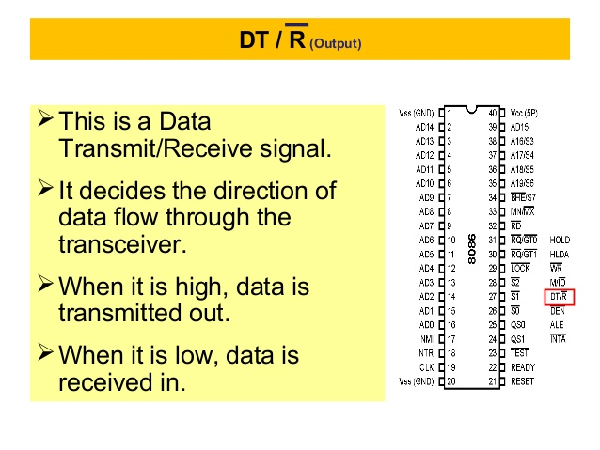

Slide 50
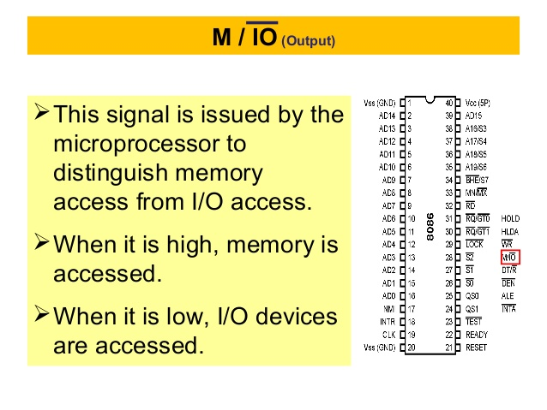

Slide 51
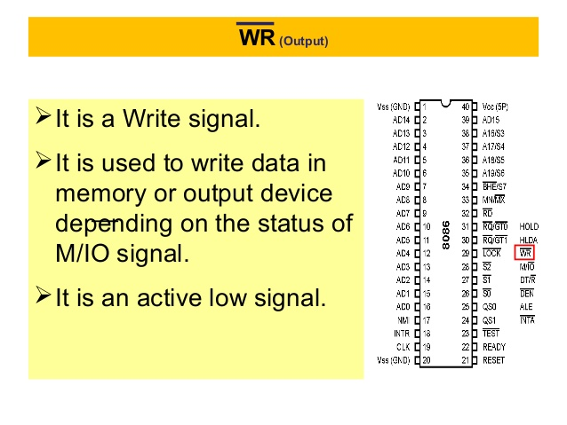

Slide 52
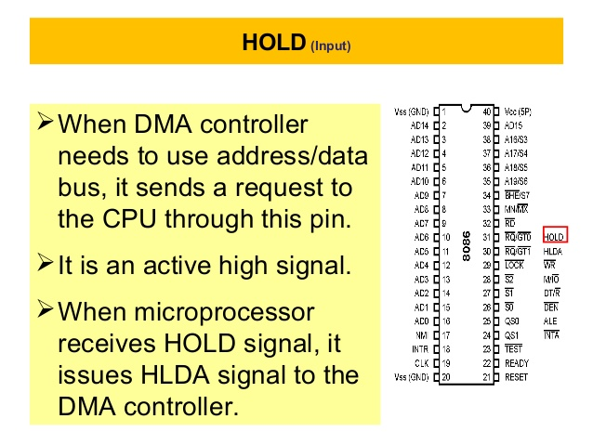

Slide 53
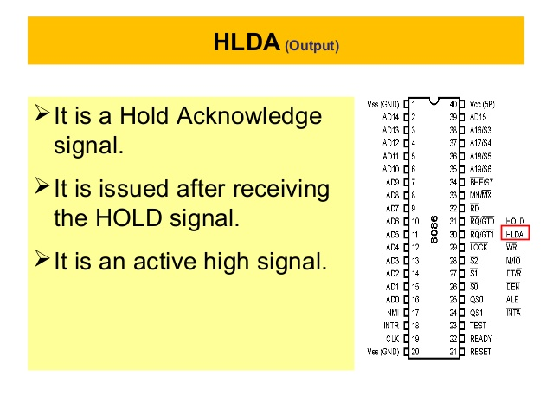

Slide 54
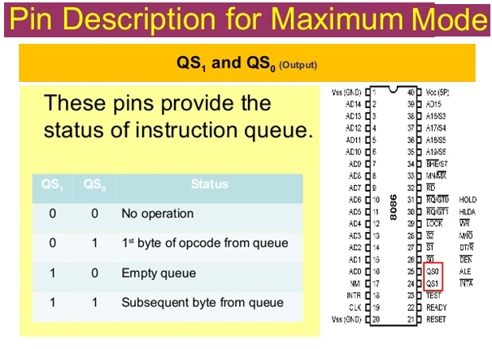

Slide 55
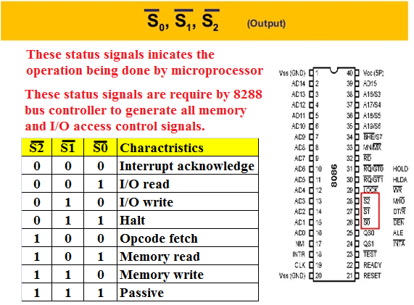

Slide 56
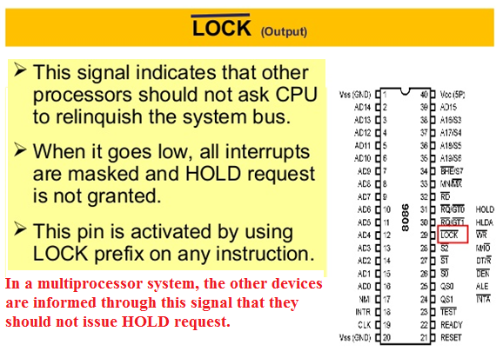

Slide 57
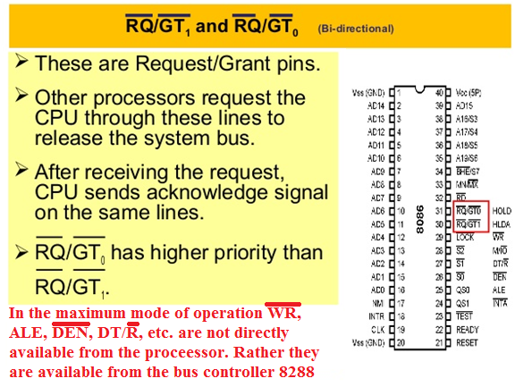

Slide 58
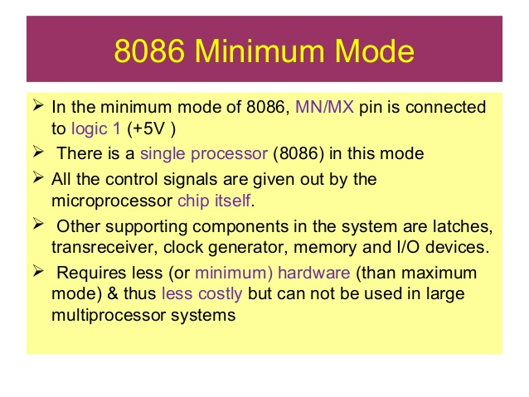

Slide 59
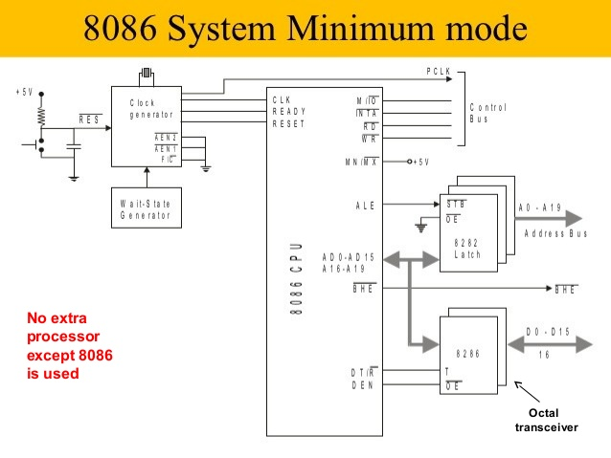

Slide 60
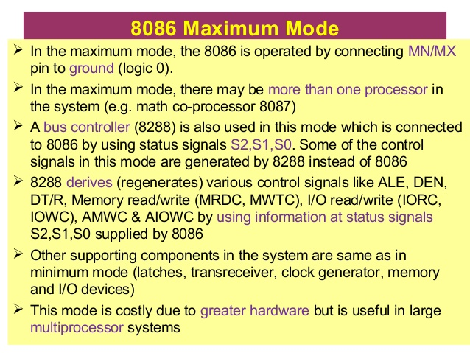

Slide 61
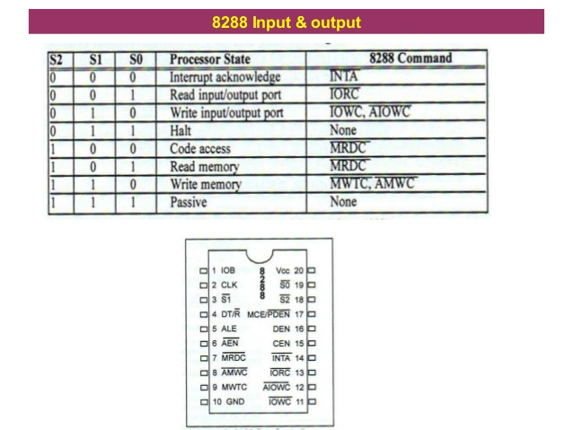

Slide 62
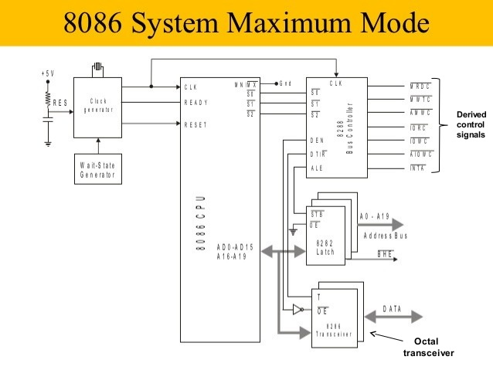

Slide 63
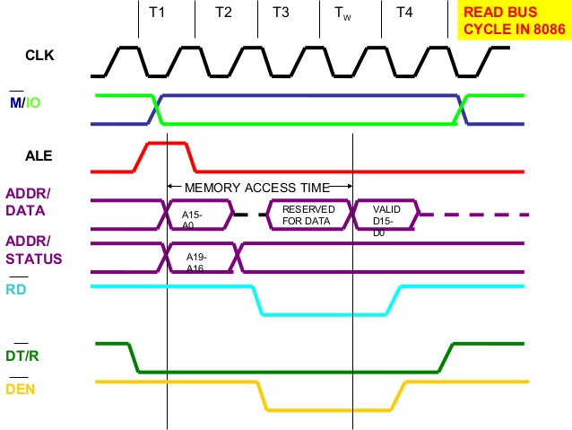

Slide 64


Slide 65


Slide 66



Slide 67


Slide 68



Slide 69



Slide 70


Slide 71


Slide 72


Slide 73


Slide 74


Slide 75


Slide 76


Slide 77


Slide 78


Slide 79


Slide 80
Any questions…….

